Slide 1



P
H
P
Stands for:

Slide 2
P
H
P
ersonal
ome
Stands for:
age

Slide 3
P
ersonal
H
ome
Stands for:
P
age

Slide 4
P
HP
H
ypertext
P
reprocessor

Slide 5





P
H
P
We Will Learn :
Syntax
Comment
Output
Variable

Slide 6
Syntax

Slide 7
<?php
// code
?>

Slide 8
Comment

Slide 9
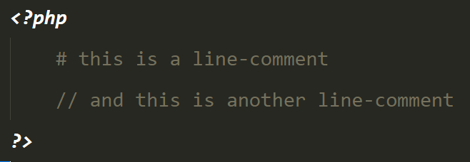
Single line:
// . . .
# . . .

Slide 10
Single line:
// . . .
# . . .

Slide 11
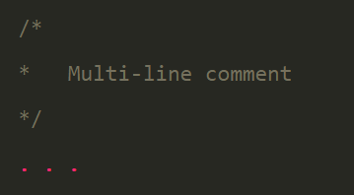
Multi line:
/* . . . . . */

Slide 12
Multi line:
/* . . . */

Slide 13
Output

Slide 14
echo “ . . . “;
VS
print “ . . . “;

Slide 15
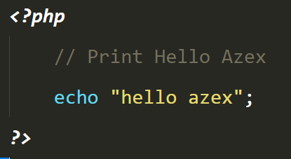

Slide 16
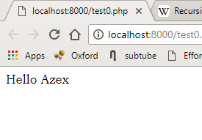

Slide 17

Sublime Time

Slide 18
Variable

Slide 19
$name = value;

Slide 20
$name = “Ahmed”;
$num = 12;
$con = true;
$name = ‘Ahmed’;
$name = ‘false’;

Slide 21
Sublime Time

Slide 22

The End

